Slide 1
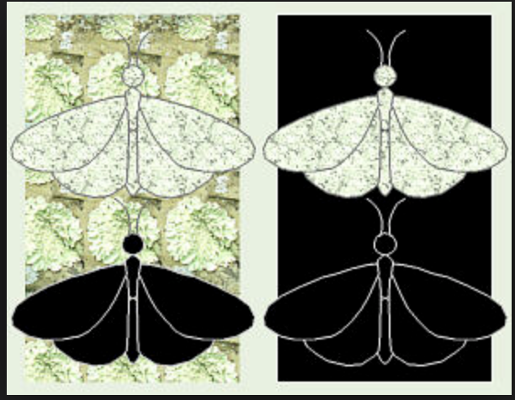
The Story of Natural Selection and the Peppered Moth

Slide 2
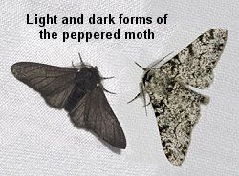
The English Peppered Moth, Biston betularia, flies at night and rests on lichen covered trees during the day. Just like how humans can have red or black hair, the moth comes in two forms of the same species - a pale speckled version which blends in with the light colored lichen on the trees, and a black, or melanic, version which is easy to see on the light trees.

Slide 3
Before the Industrial Revolution, trees were covered in light colored lichen and the pale form was easily camouflaged during the day. The melanic form was a dark contrast to the light background so birds easily found them and they were eaten more frequently. As a result, they were less likely to survive and pass their genes on to the next generation which made this form of moth rare within the population.

Slide 4
In the late 1700s and early to mid-1800s, the Industrial Revolution created air pollution so thick that it killed the lichens and covered the trees in black soot.

Slide 5
As a result, the pale moths stood out against the black background and birds caught them more easily while the melanic form was well- camouflaged allowing them to survive, breed, and pass the dark coloration on to their offspring. The melanic moth became more common among the peppered moths due to selective pressure the birds put on the population due to their inability to find camouflaged forms.

Slide 6
In the 1950s, pollution became regulated (by the Clean Air Act) and as a result, the trees took on their original appearance and lichens again flourished. As a result of reverse selective pressure, the melanic form decreased while the pale form increased in numbers. It is expected that with the current trend, the gene for melanic moths could be completely eliminated from the peppered moth population within the next few years.

Slide 7
#1 Before Industrial Revolution
#2 During Industrial Revolution
#3 After Clean Air Act was passed and smog went away
The peppered moth story provides evidence for changes of frequencies of different forms of a species within a population. However, it does not show large scale Evolution.

