Slide 1
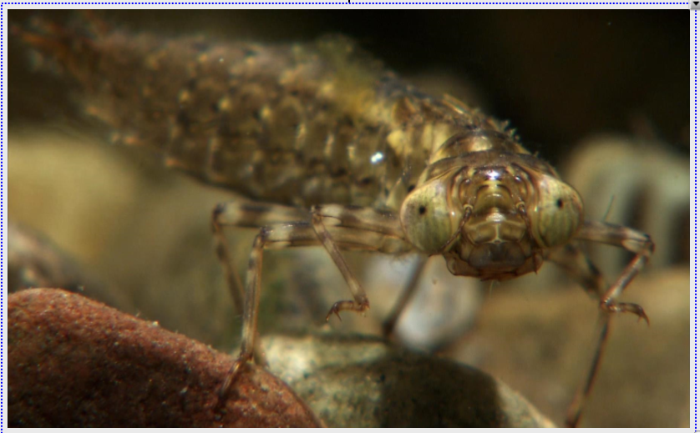

Slide 2
Read the article on Leaves “Energize” our Streams and answer questions.

Slide 3
MICROBES
A microbe, or “microscopic organism,” is a living thing that is too small to be seen with the naked eye.
Examples:
Bacteria
Archaea (r key a)
Fungi
Protists
Virus
Microscopic Animals
MACROINVERTEBRATES
Macroinvertebrates are organisms that lack a spine and are large enough to be seen with the naked eye.
Examples:
flatworms, crayfish, snails, clams and insects, such as dragonflies.

Slide 4
Watch Leaf Pack video from 6:19 to 9:00
https://recordings.join.me/UR_KvQV-XE6FGQpI7Jnn2w

Slide 5
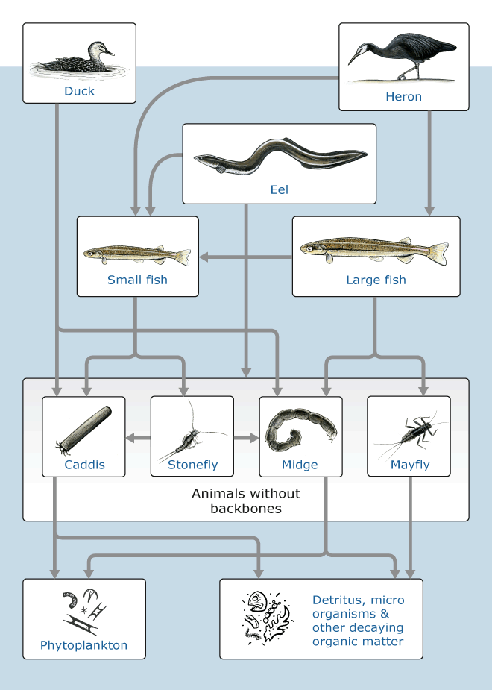

Slide 6
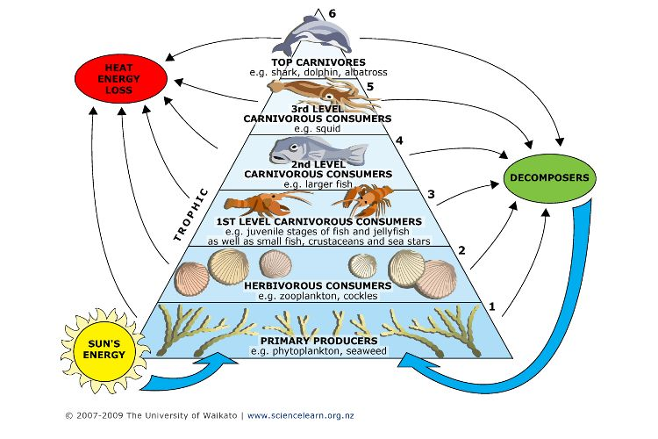

Slide 8
LEAF PACK Macroinvertebrate PICTURES

Slide 10
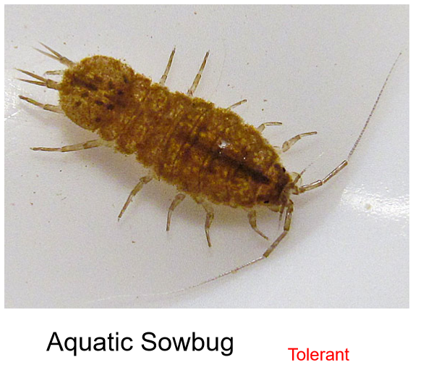

Slide 11
Tolerant

Slide 14
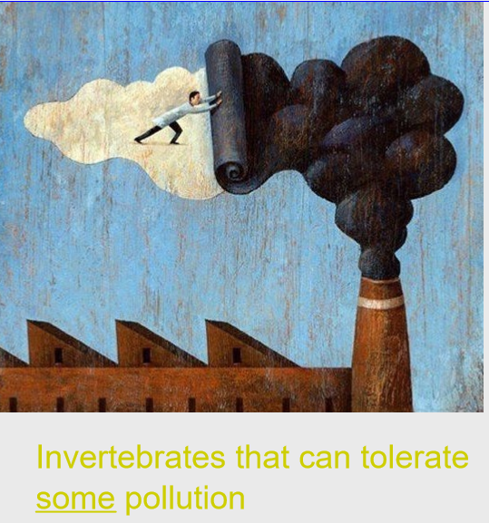

Slide 17
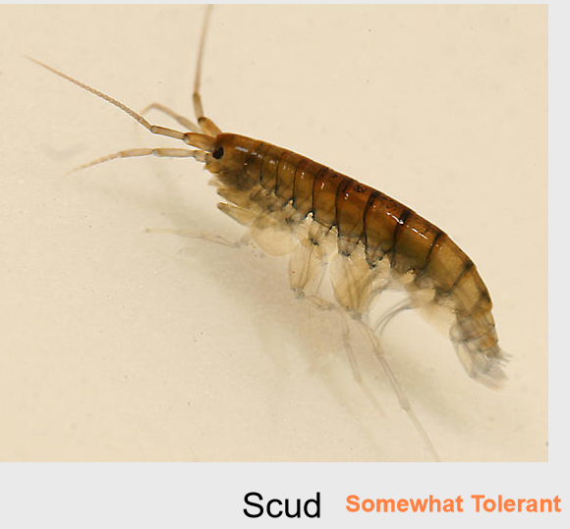

Slide 18
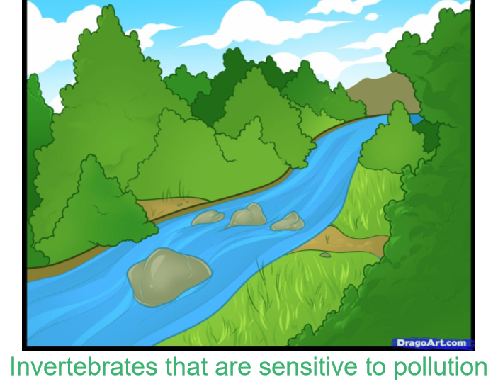

Slide 21
