Slide 1
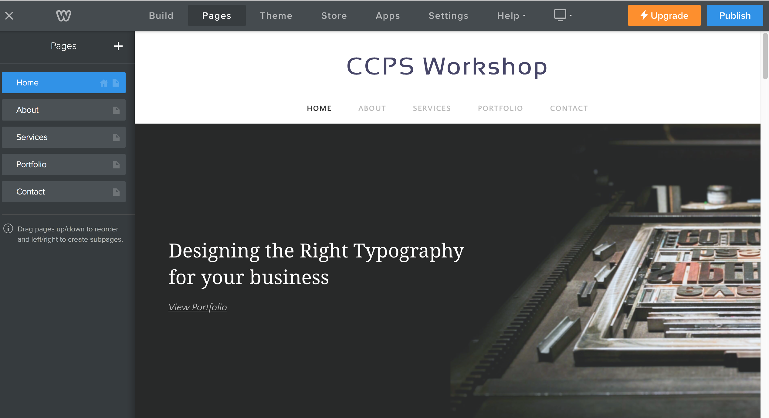
Building
Click here
Page Headings
2. Click on Pages
Notice that the left menu changes.
-delete any existing pages
-add new pages (one at a time)
-headings should to match each of our six pages.
NOTE: At any time click PUBLISH, to see how the page looks.

Slide 2
EXAMPLE OF PAGE ORGANIZATION--
PAGES CAN BE REARRANGED, ADD, OR DELETED AS NEEDED.

Slide 3
Intro to Content Elements
NOTE: At any time click PUBLISH, to see how the page looks.

Slide 4
NOTE: At any time click PUBLISH, to see how the page looks.

Slide 5
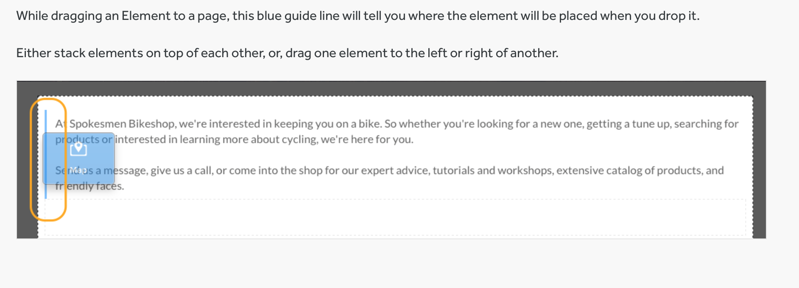

Slide 6
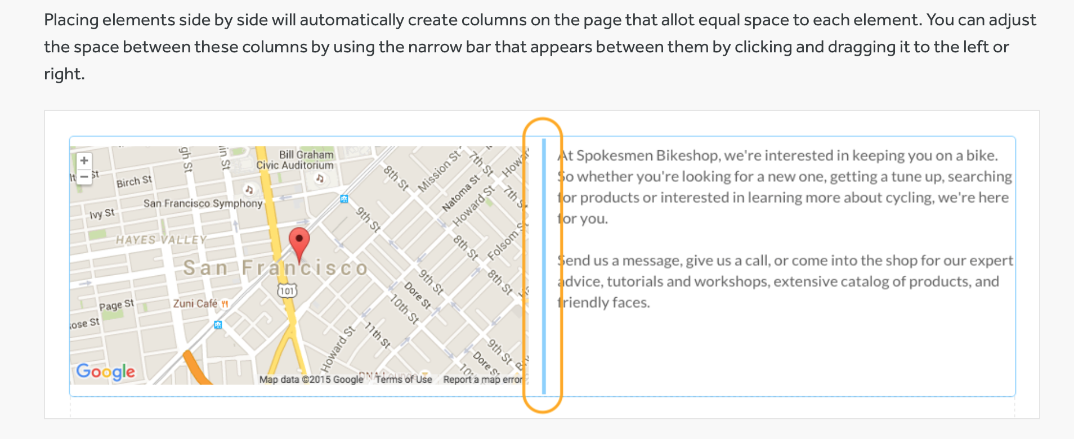

Slide 8
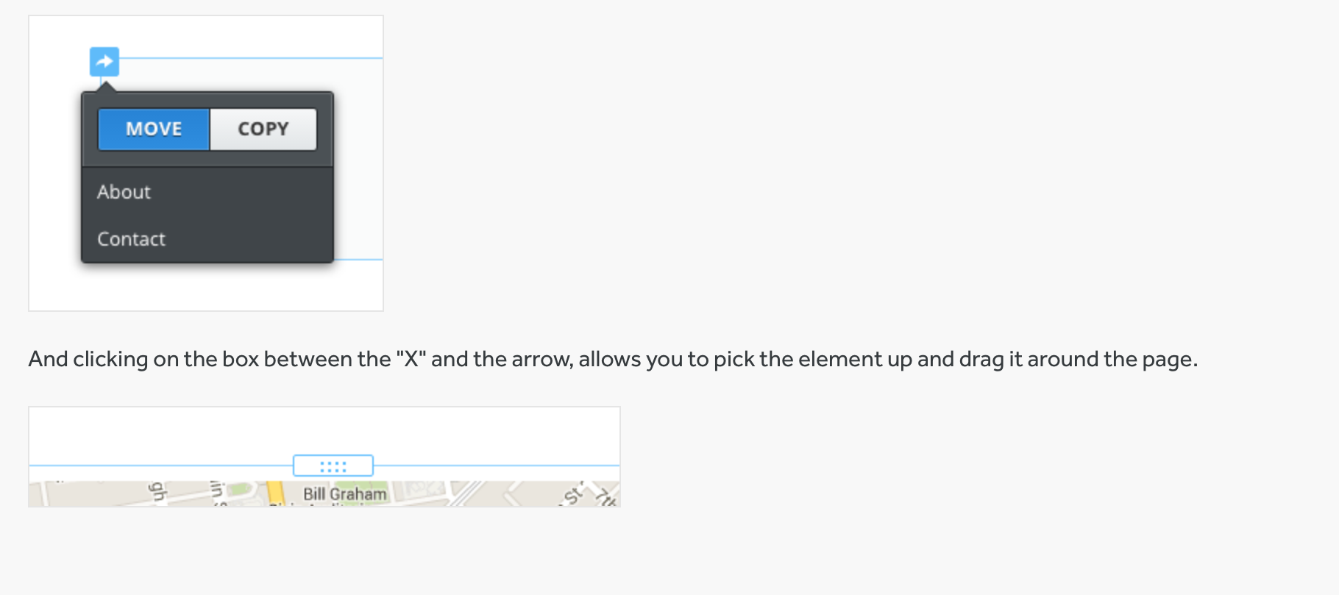
The arrow in the upper left allows you to copy an element to the same page or another page or to move an element to another page.
And clicking on the box between the “X” and the arrow allows you to pick up the element and drag it around the page.

