Slide 1
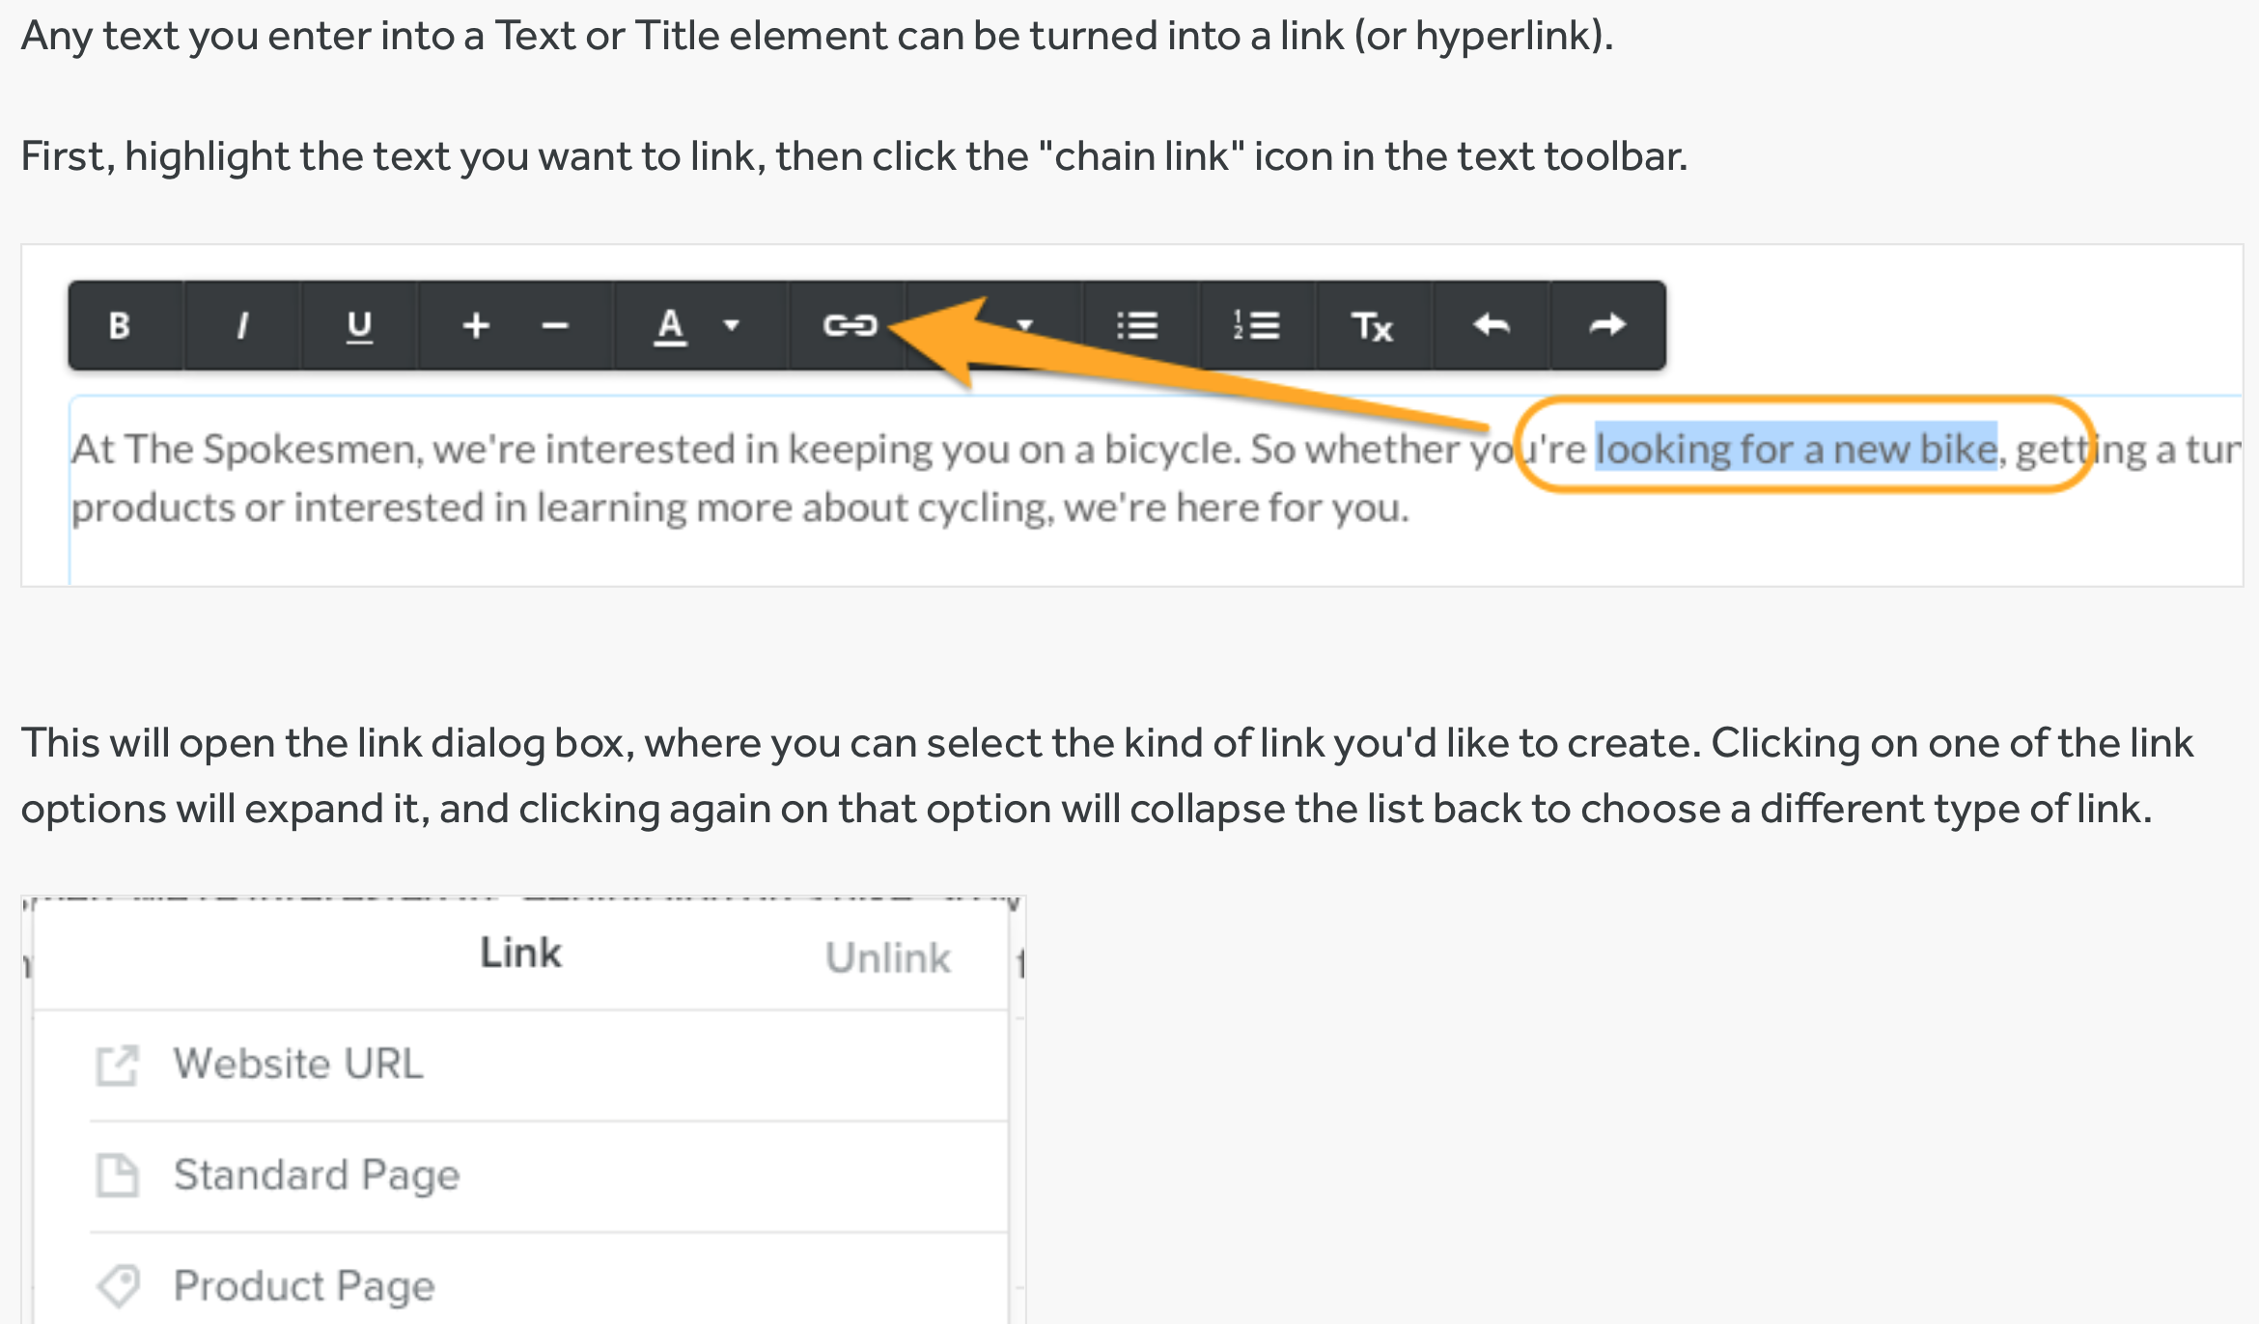
Create Links https://youtu.be/nuj7acOe7qk

Slide 2
Image Link
You can also turn any image element into a link.
Click the image you want to use, then select Link from the image toolbox.

Slide 3
Undo a Change (The following is from Weebly.com)
Did you switch to a different theme and then decide to go back to the old one? You can go back to a previous theme easily - just click on the Themes tab, then on Change Theme, and then on the Recently Used tab. You should see your previous theme there, allowing you to switch right back.

Slide 4
Did you make a mistake while typing in a text element? If your cursor is still inside the text element, then you can use the undo and redo arrows to perform several levels of undo and redo. Keep in mind that your text will be automatically saved once you click outside of the element, so you won't be able to use the undo/redo buttons after that. Also, if you deleted a file or image from inside an element, we don't have a way to restore that either.

Slide 5
NOTES FROM WEEBLY!
Did you accidentally delete a page? Good news! We can restore deleted pages for you. Get in touch and let us know the name of the page you deleted, the name of the website, and the date when you deleted the page.

Slide 6
Accidentally delete a website? We can also bring this back for you if you contact us. We'll need to know the name of the site and approximately when you deleted it.
What if you deleted your entire Weebly account?
We can undo that for you, too! Just reach out and let us know the email address you used to log into the account.

Slide 7
Here's a quick rundown of what we can not restore for you:
Blog posts or drafts that were deleted
Sections deleted from a page.
Contact Form entries that were deleted
Uploaded images or files that were deleted
Products or categories deleted from the Store
Custom themes that have been deleted from the Themes tab
Files/images deleted from the assets area of the code editor
Elements deleted from a page
Members and Member Groups deleted from Settings > Members
Apps from the App Center that you removed via Settings > My Apps (you can just re-add them from the App Center, though)

Slide 8
For more help – hc.weebly.com (Weebly Help Center)
https://hc.weebly.com

