Slide 1
Adaptations

Slide 2
Adaptations to an Environment
Every _________ has a variety of adaptations that are suited to its specific living conditions
An ____________ is a trait that an organism has ________ that helps it __________ and reproduce in their habitat
Ex. Sharks sense of _______, shape of a bird’s beak, dogs can hear well, flowers have bright _________
Physical adaptations do not develop during one lifetime, but over _________ generations
__________ that help determine _________ are passed from parent to offspring

Slide 3
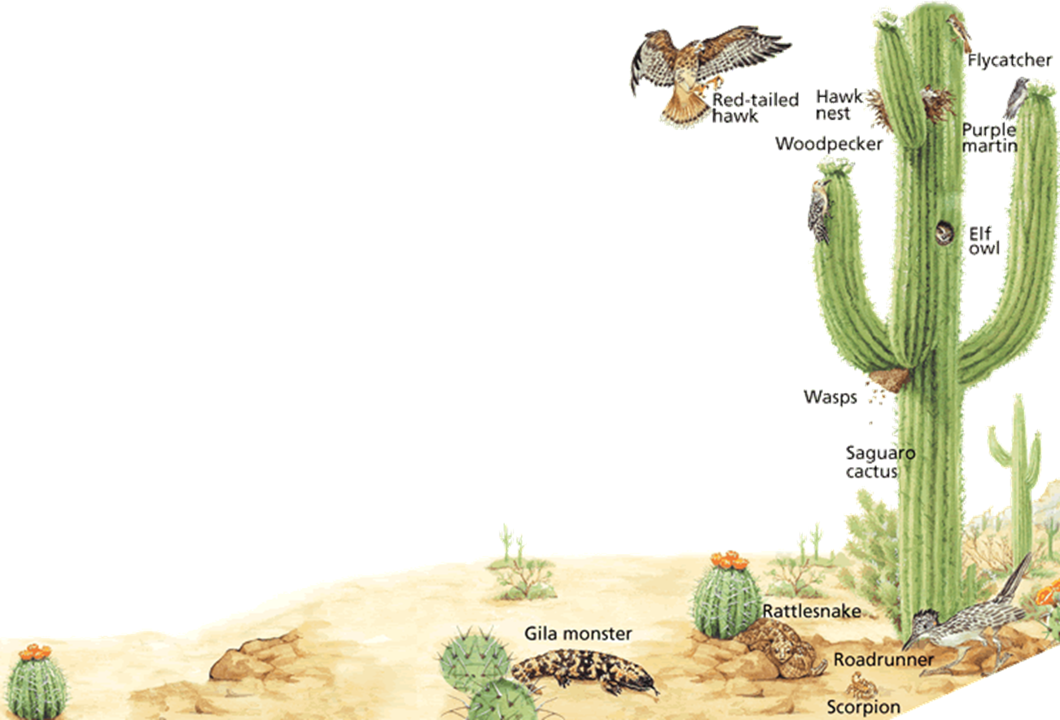
How many traits can you find that are adaptations to this environment?

Slide 4
Adaptations Over Time
____________________ is the process by which individuals who are better adapted to their _______________ are more likely to survive and _____________ than other members of the same species.

Slide 5
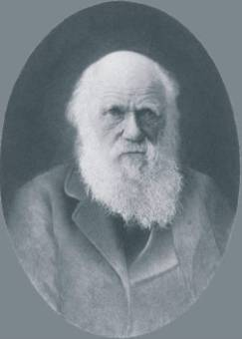
Charles Darwin/Finches Galapagos Islands
__________________- English scientist who proposed the theory of natural selection in 1859.
Sailed on the Beagle to ______________ for research
Studied tortoises, ___________, lizards, and other animals on the islands.

Slide 6
Animals of Galapagos Islands
Finches- __________ are adapted for different feeding behaviors
Ex: insects, seeds, fruit
Iguanas- able to ________ underwater to eat algae, _____________to cling to rocks, expel salt by sneezing
Tortoises- ______________ depends on island environment

Slide 7
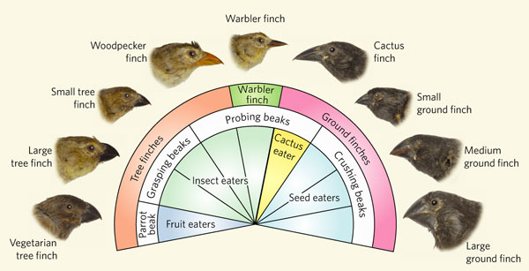
Finch Beaks

Slide 8
Causes for Adaptations Among Species:
Inheriting traits/variations that have advantages for survival or reproduction
Overpopulation/competition
Environment/Climate

Slide 9
Variations
______________ are different ways that a trait can express itself
Some variations make individuals ______ fit for survival from predators allowing them to reproduce and ______ the favorable trait to their offspring
Ex. Variations among turtles make some of them better able to survive. Turtles that survive to become adults will be able to reproduce.

Slide 10
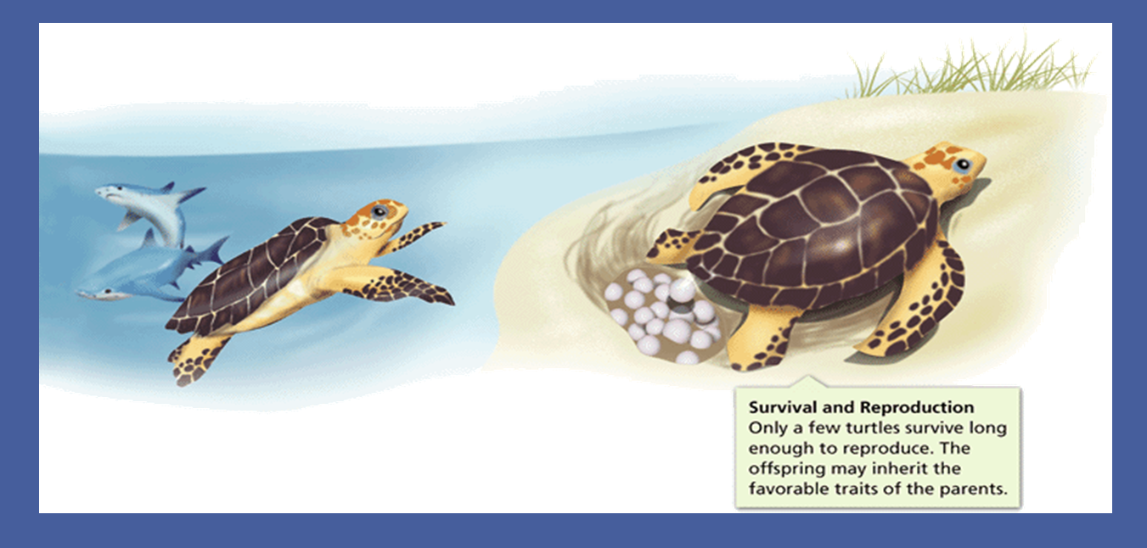
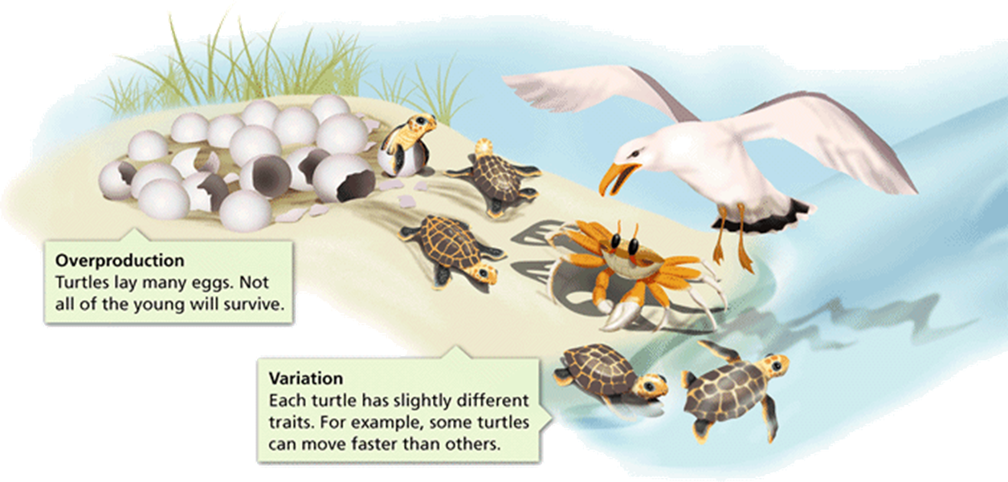
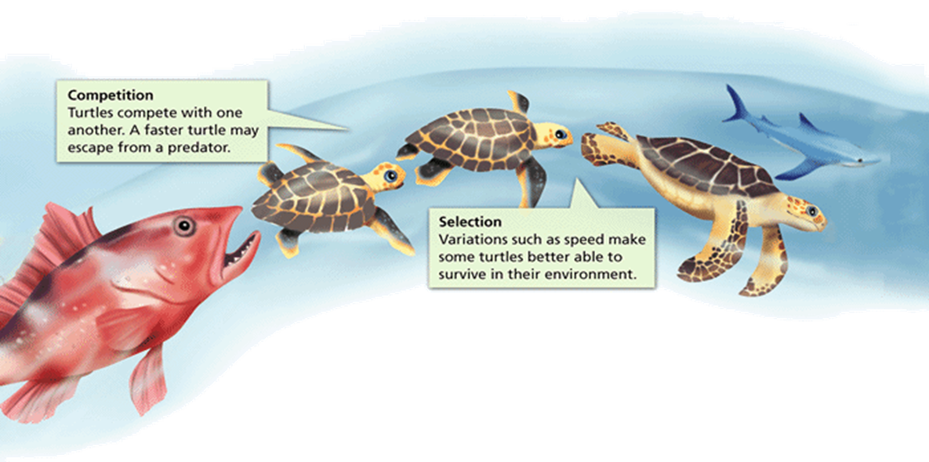
Variations that have advantages for survival and reproduction

Slide 11
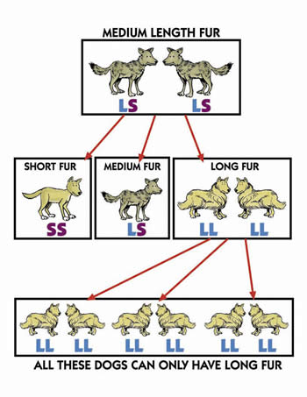
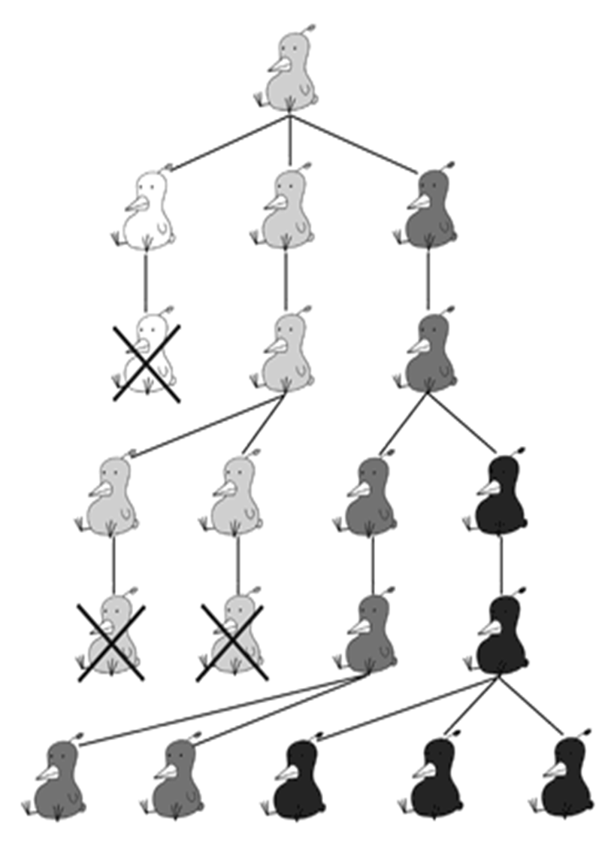
Inherited Traits

Slide 12
Natural Selection by Environment
Variations can also allow organisms to become better adapted to survive in a particular _____________.
Organisms expressing traits that allow them to survive & reproduce in a particular environment will become the ____________ life within the environment.

Slide 13
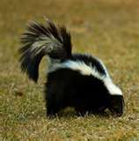
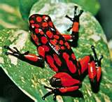
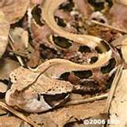
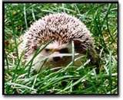
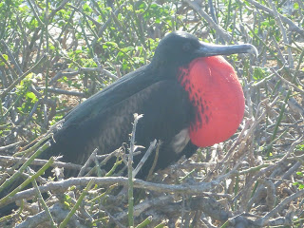
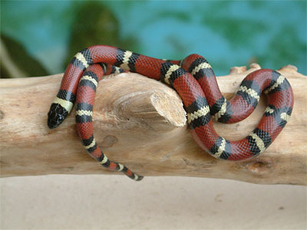
Example of inherited traits for survival & reproduction
__________________
Snake
__________________
Mexican Milk Snake
__________________
Skunk and Poison Arrow Frog
“Hair” projections
Hedgehog quills
Deer Antlers
________________ behaviors
Male birds dance & have colors to attract mates

