Slide 1
3. Homologous Structures
Homologous Structures are bodily structures, in organisms that share a common ancestor, that are similar in structure, but different in function.

Slide 2
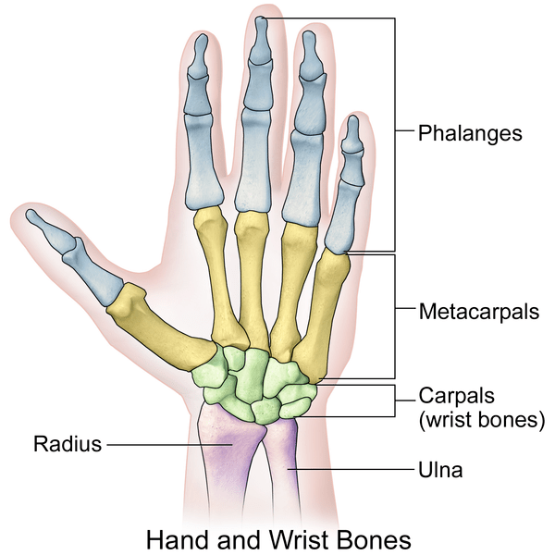
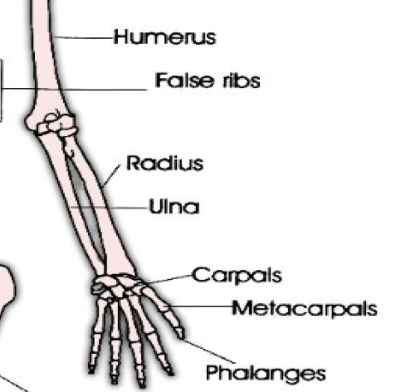
Focus on Human Arm

Slide 3
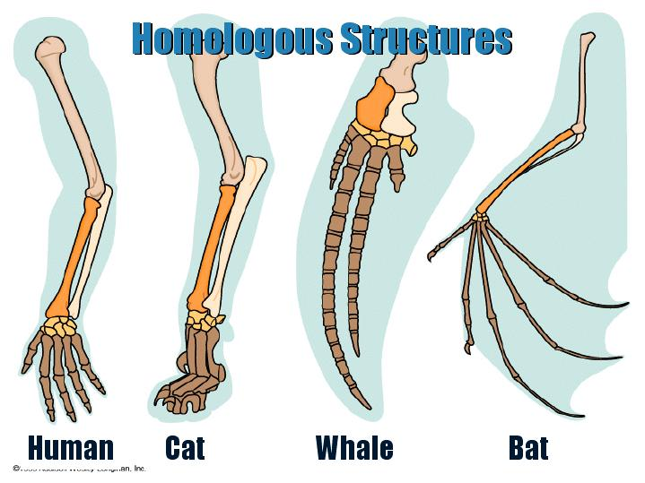

Slide 4
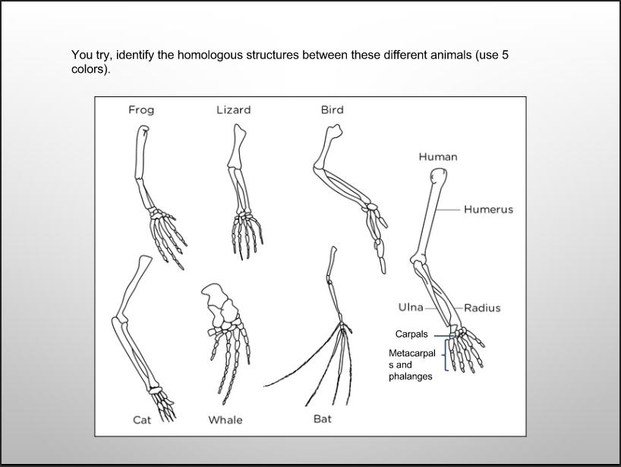

Slide 5
