Slide 1
Foldable Notes for Evolution, Natural Selection, Genetic Variation Adaptation and Competitive Advantage
Megonigal
2017-2018

Slide 2
Why do giraffes have such long necks?
A giraffe’s long neck is an ADAPTATION that helps the giraffe survive in its environment.
A species doesn’t know what traits will be advantageous in the future (it’s pure genetics).
The long neck was
NOT grown on purpose
NOT a result of the giraffe stretching.
From Life Science textbook (pg 533)

Slide 3
Darwin’s Theory of Evolution by natural selection
According to Darwin’s theory, some variations give organisms an advantage in their environment. Therefore, they are better able to survive and leave more offspring than organisms without the variation.
Evolution occurs when a new species of organisms develops from an existing species over time.
Evolution is a change in a species over time (not individuals or environments).

Slide 5
Genetic Variation
Darwin noticed that with a population, there are differences in traits.
Slight differences in an inherited trait among individual members of a species is called variations.
Genetic variations are a result differences in DNA.

Slide 6
Variations in the same species of a ladybugs!
Which ladybug’s pattern will be the most advantageous in a million years?
MINE!
N0T all variations matter!

Slide 8
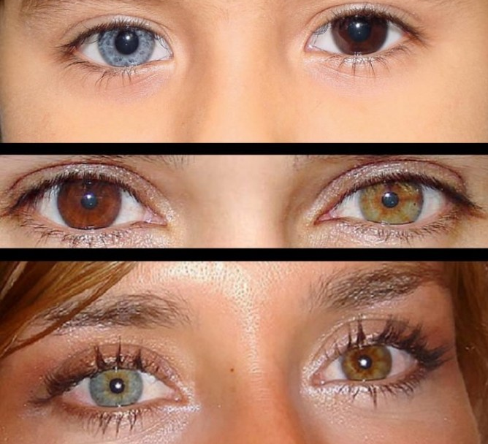
Sources of Variations in organisms
Sexual Reproduction
Random genetic mutations
For example, Heterochromia
a difference in coloration, usually of the iris. Heterochromia may be inherited or caused by a genetic mutation or a disease or an injury.

Slide 9
Natural Selection –
a process in nature by which organisms better adapted to their environments tend to survive and reproduce more than those less adapted to the environment.

Slide 10
An adaptation is any structural, physiological, or behavioral trait that aids an organism's survival and ability to reproduce in its existing environment.

Slide 11
Must know vocabulary
Evolution-
A gradual change in a species over time (typically, a very long time).
Natural Selection –
a process in nature by which organisms better adapted to their environments tend to survive and reproduce more than those less adapted to the environment.
Adaptation-
Any characteristic of an organism that enables it to survive well in its environment.
Genetic Variation-
Genetic variation is the difference in DNA sequences between individuals within a population.

Slide 12
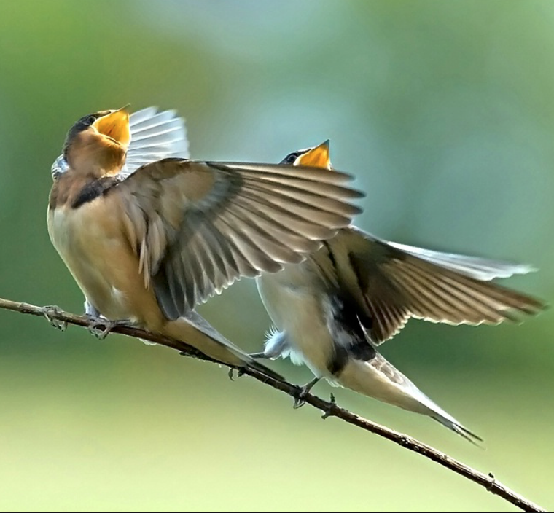
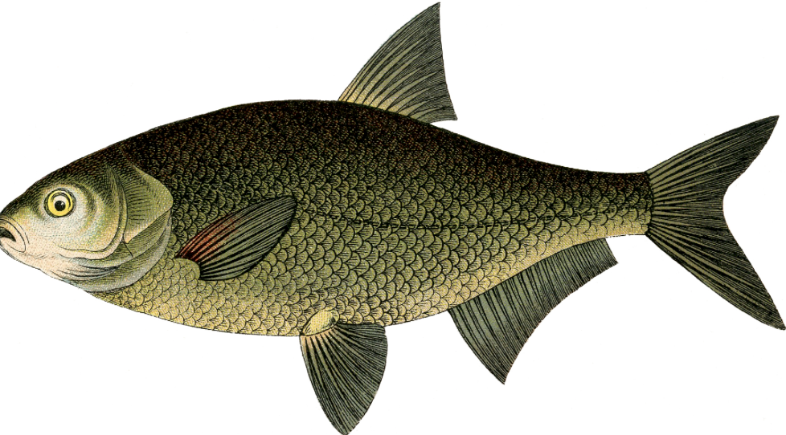
Competitive Advantage-
a condition or circumstance that puts an organism in a more favorable position than another organism.
A better display may help finding a mate easier.
Stronger fins may help fish swim faster and escape predators.
A better song may help finding mate easier.

Slide 13
Speciation- the process of evolving into separate species To learn more watch the Amoeba Sisters video.
Amoeba Sisters on Speciation

