Slide 1
Thursday, Sept 7th, 2017
OBJ: SW Practice collecting evidence to solve the cube puzzle
and then evidence hidden in the fossil record.
WU: Pick up the two slips of paper by the door on scientific evidence and fossil record. Glue them in your composition notebook.
Agenda:
-Finish part 2 of the block activity. (PD 1,2,4,5)
-Only periods 2,4,5 will spend 10 minutes planning their own cube puzzle.
-Assign computers; learn how to get logged in.
- Go to nms8thgradescience.weebly.com
-Complete only the “Past Lives” section of the fossil record evidence chart
using the “STORIES IN THE FOSSIL RECORD” website.
HW: none

Slide 2
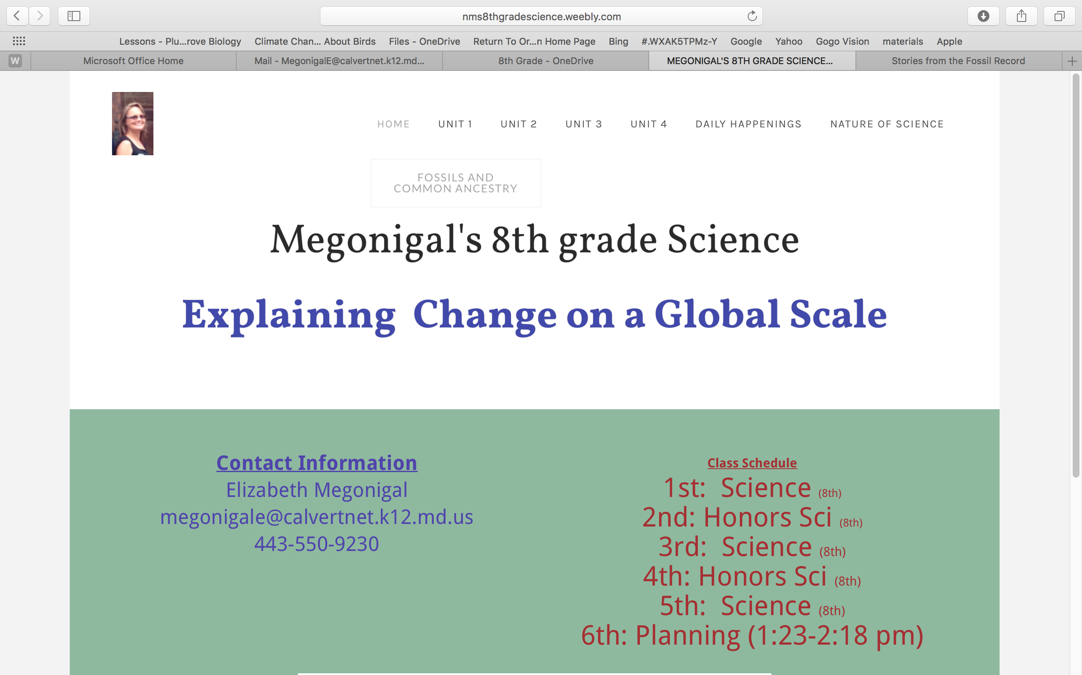
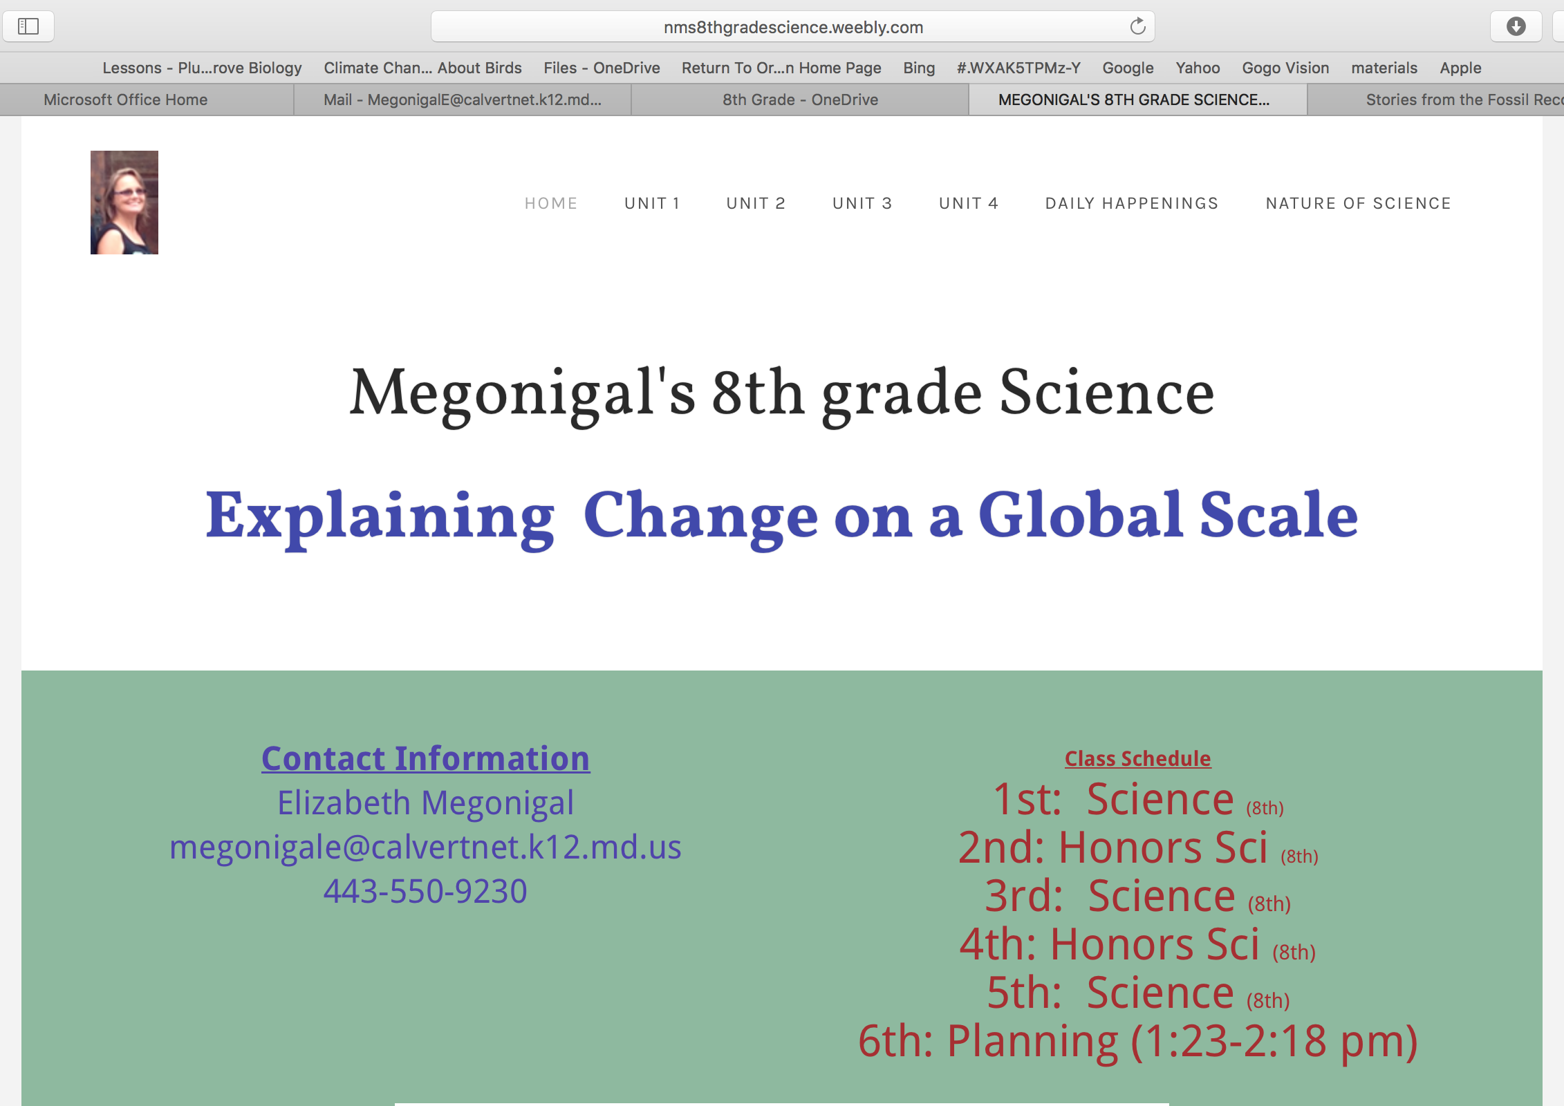
nms8thgradescience.weebly.com
First
Second

Slide 3
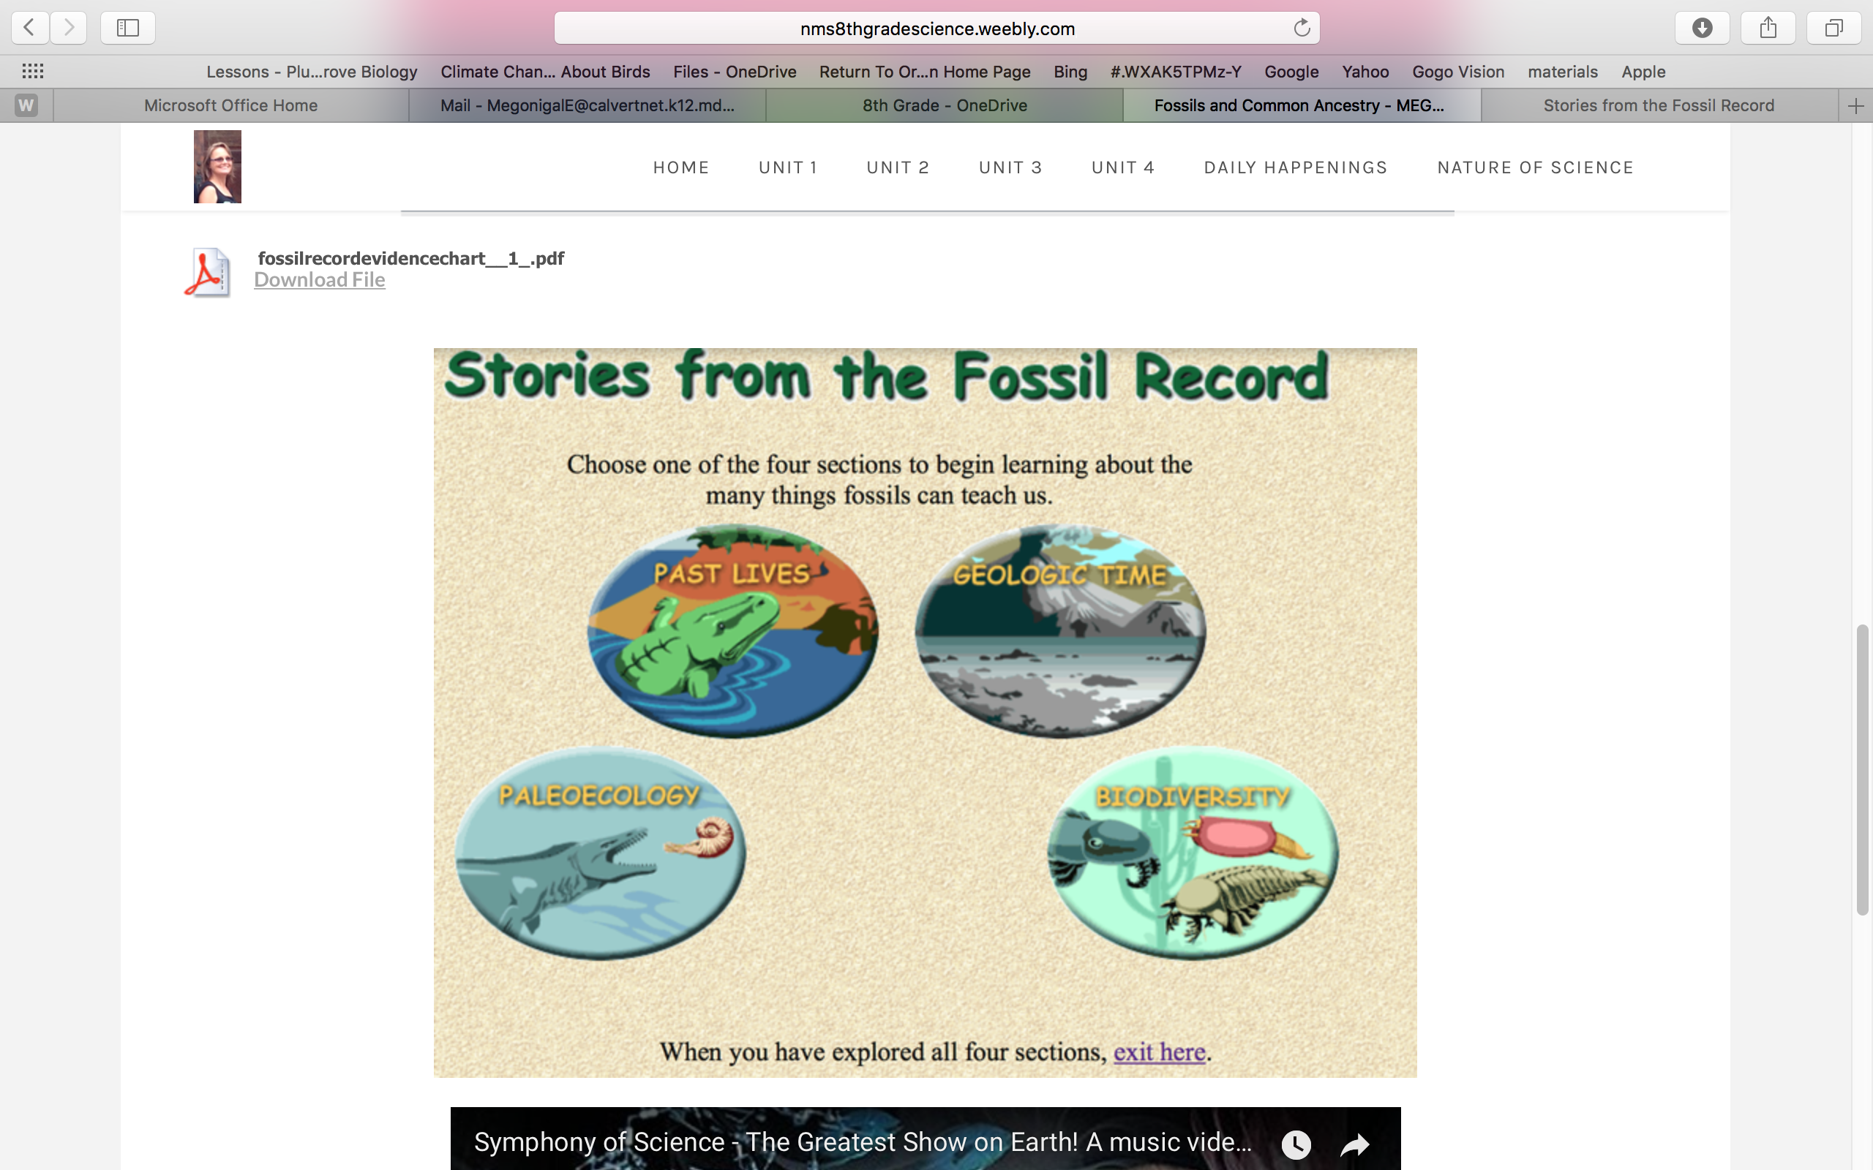
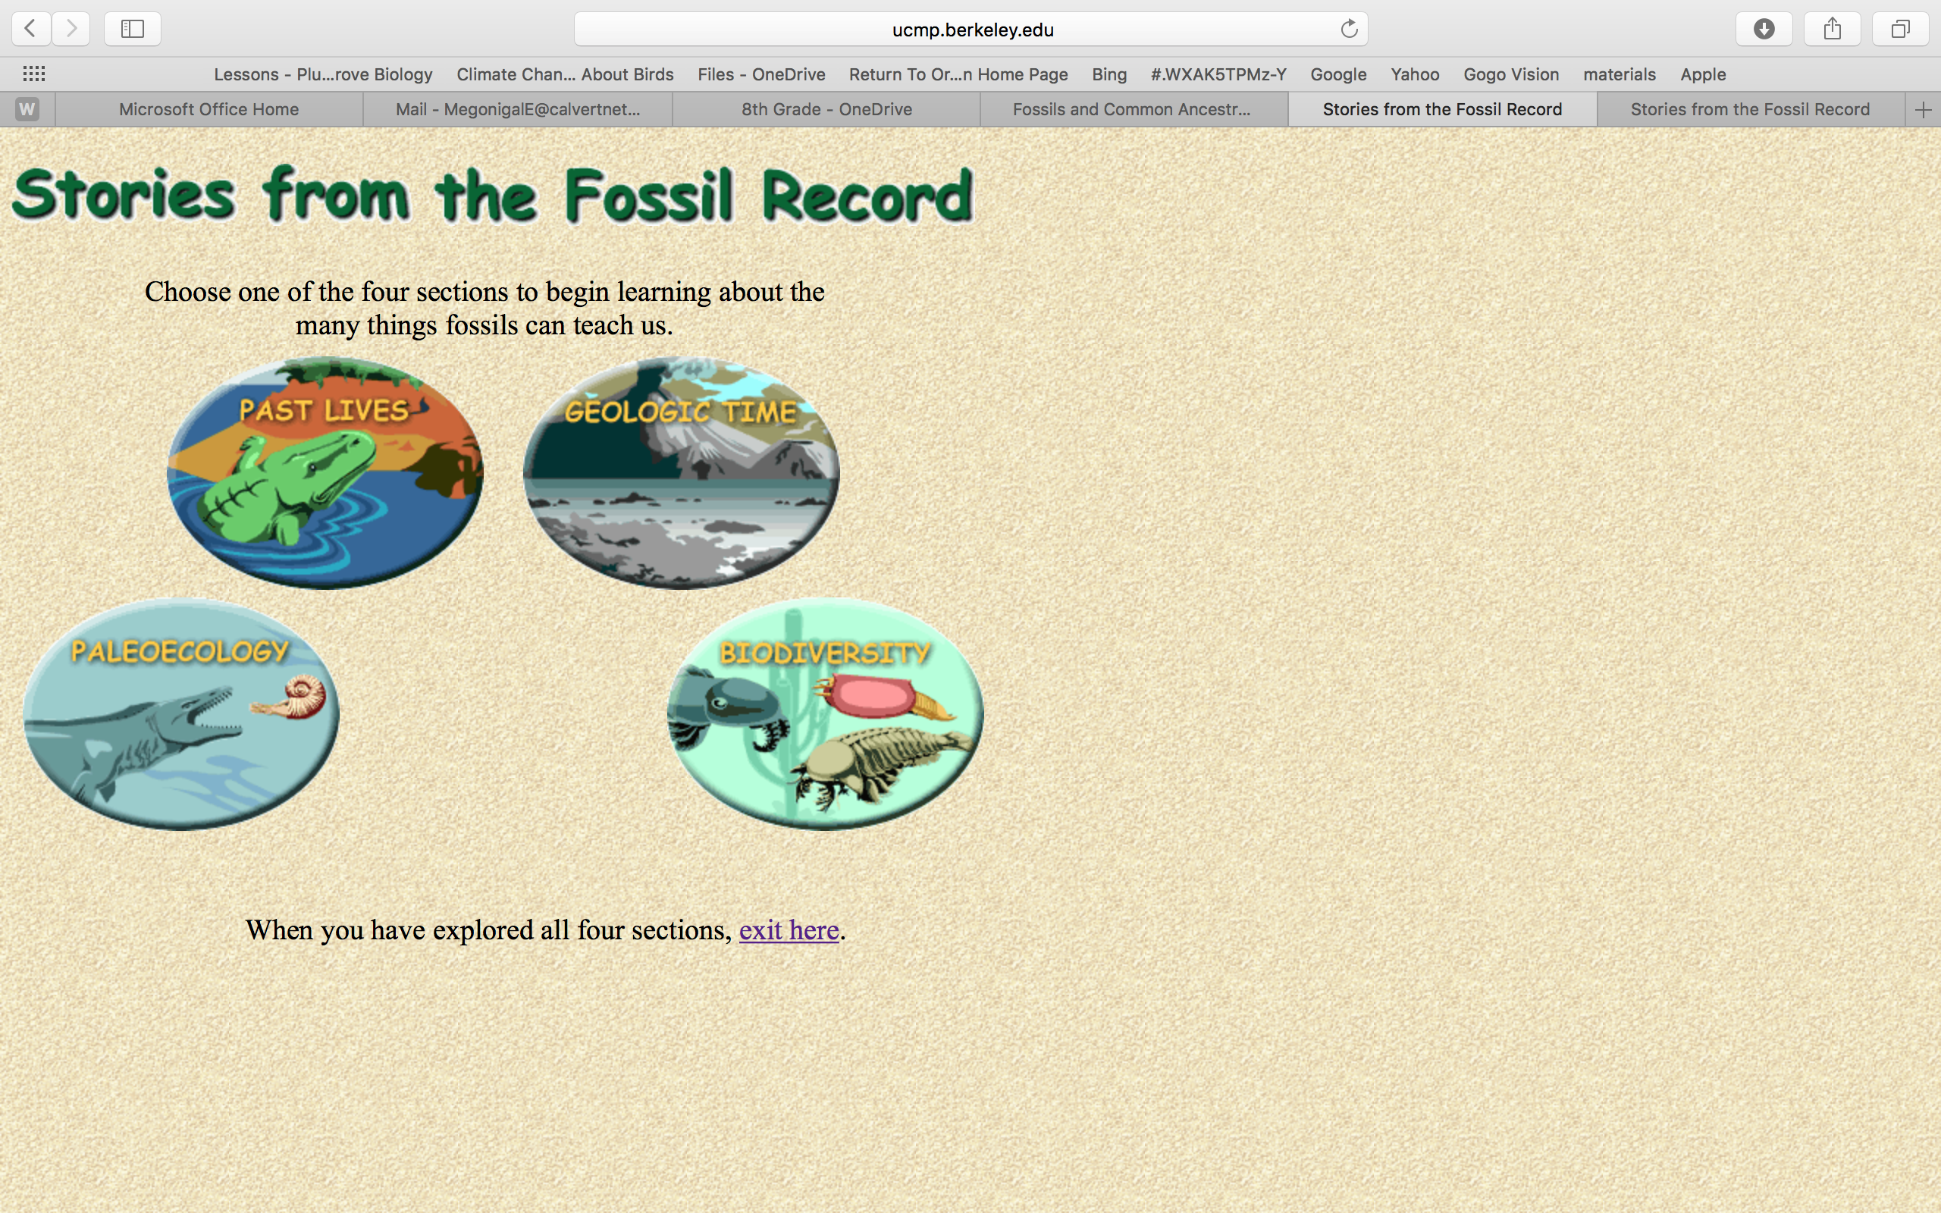
Third- Scroll down the page until you find “Stories from the Fossil Record”. Then click on it.
Fourth- Click on Past Lives, then each of the others to find your information.

