Slide 1
4. Vestigial Structures
Vestigial structures are structures that serve no function in the present organism, BUT were useful structures in earlier ancestors
human ear muscles
human tailbone
human appendix

Slide 2
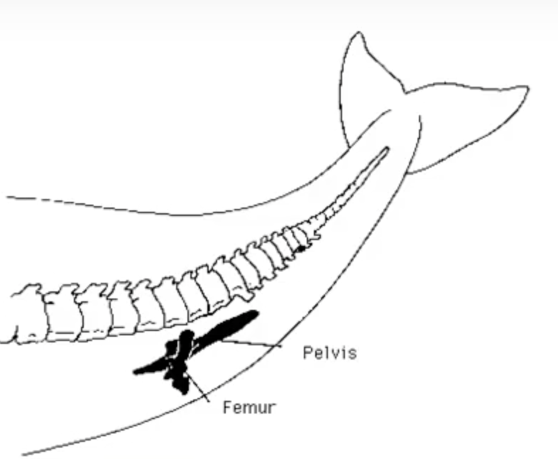
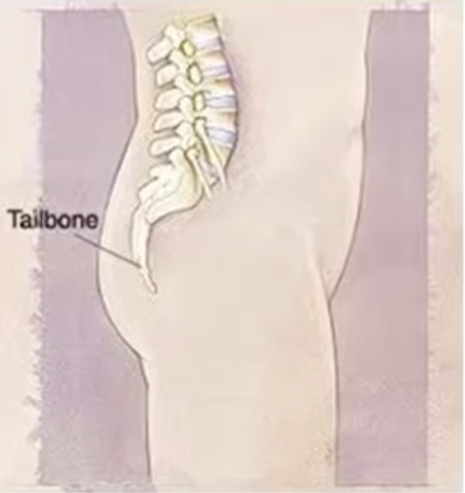
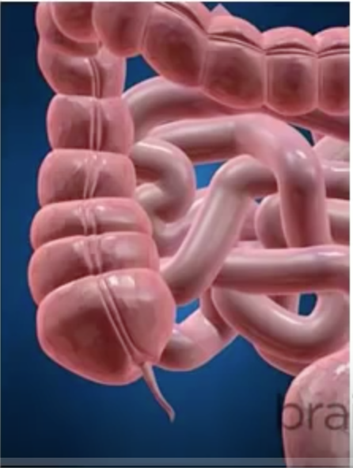
Features present in modern animals that are no longer in use.
Vestigial structures give hints as to the evolution of organisms.
Can include neurological pathways, structures and organs.
whale pelvis
tailbone
appendix

Slide 3
https://www.youtube.com/watch?v=9VyrbG7FZ2Q

Slide 4
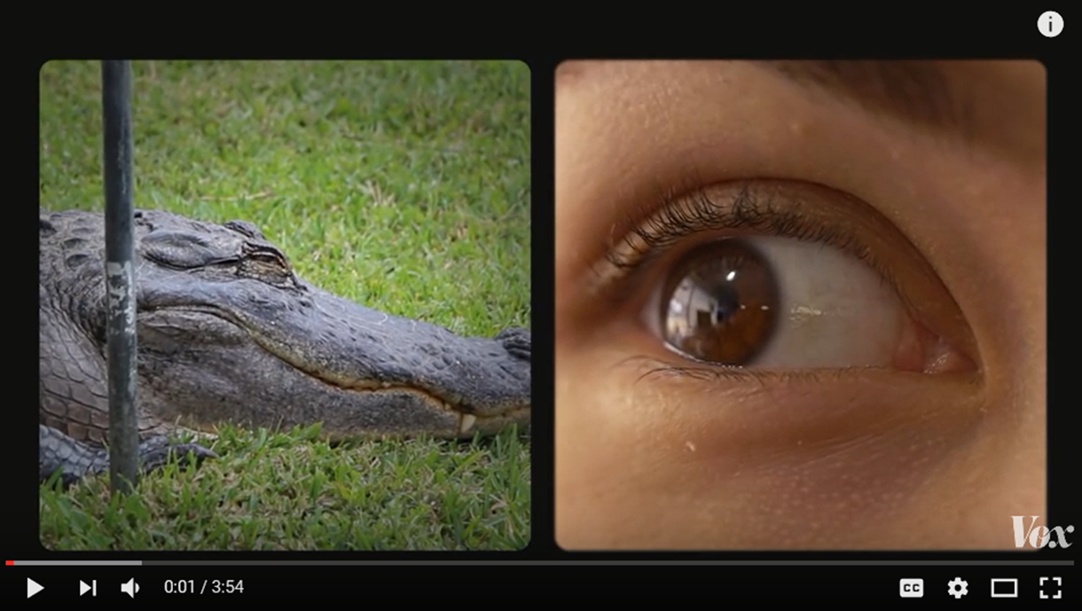
What evidence do we have that organisms change over time?
Vestigial Parts
https://www.youtube.com/watch?v=rFxu7NEoKC8

Slide 5
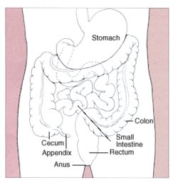
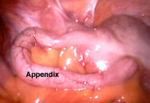

Slide 7
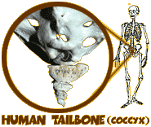
Vestigial Organs
Login Instructions

Slide 8
Major Evidence for Evolution
Fossil record ✔
Morphology ✔
Homologous structures ✔
Vestigial structures✔
Analogous structures
Embryological development
Biochemical evidence--DNA

